Slide 1

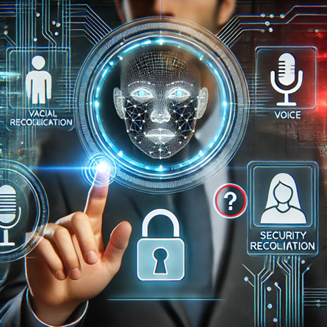
Locking/Unlocking Decision System Based on Person Identity Recognition Sub topic: Integrated Locking System Based on Face and Voice Recognition with Security Questions
Author: Bharath Neelakrishnan
Supervisor: Audrius Zajančkauskas
Date: 30/01/2025

Slide 2
Overview
Objective:
Develop a secure locking system integrating facial recognition, voice recognition, and security questions.
Key Features:
Multi-factor authentication.
Real-time processing.
User-friendly interface

Slide 3
Introduction
Traditional authentication methods (e.g., passwords, PINs) are vulnerable.
Multi-Factor Authentication (MFA) enhances security.
Proposed system integrates facial recognition, voice authentication, and cognitive security

Slide 4
Goals and Tasks
Goal:
Develop a secure, robust, and user-friendly authentication system.
Tasks:
Analyze vulnerabilities in existing authentication methods.
Develop a hybrid authentication system (face + voice + cognitive security).
Implement spoof detection and liveness verification.
Evaluate system performance based on real-world datasets.

Slide 5
LITERATURE REVIEW:
Facial Recognition:
FaceNet & Mediapipe used for high-accuracy facial verification.
Challenges: Lighting, pose variations, spoofing (deepfake attacks).
Voice Authentication:
Uses DeepSpeech & MFCCs to analyze voice patterns.
Challenges: Background noise, replay attacks, and voice synthesis.
Multi-Factor Authentication (MFA):
Cognitive security questions improve authentication security.
Research Gap: Limited studies on real-world usability of hybrid MFA.
Contribution:
A multi-modal approach that compensates for weaknesses in individual modalities.

Slide 6
Implementation
Study | Methodology | Dataset Used | Accuracy | Strengths | Limitations
Turk & Pentland (1991) | Eigenfaces (PCA) for face recognition | ORL Database | ~85% | Early face recognition model, efficient on small datasets | Poor performance under lighting variations
Belhumeur et al. (1997) | Fisherfaces (LDA) for feature extraction | FERET | ~88% | Improved lighting invariance | Limited robustness against pose variations
Taigman et al. (2014) | DeepFace (CNN-based) | Facebook dataset | 97.35% | High accuracy, deep learning-based | Requires large computational resources
Schroff et al. (2015) | FaceNet (Triplet loss-based CNN) | LFW | 99.63% | Compact face embeddings, scalable | High memory requirements
Li & Jain (2019) | Anti-spoofing for face recognition | MSU MFSD | ~95% | Spoof detection for deepfake prevention | Limited generalization to unseen attacks
Reynolds (1995) | Gaussian Mixture Model (GMM) for voice recognition | TIMIT | ~80% | Early statistical model for speaker verification | Poor noise robustness
Hannun et al. (2014) | DeepSpeech (RNN-based) | Librispeech | ~96% | End-to-end deep learning-based, robust to noise | High computational cost
Paul et al. (2020) | Voice Liveness Detection | Custom dataset | ~94% | Anti-spoofing measures for voice authentication | Limited dataset availability

Slide 7

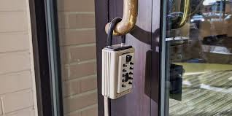
Problem Statement
Challenges with Existing Systems:
Passwords are vulnerable to brute force attacks.
PIN codes can be observed or guessed.
Fingerprint recognition is affected by wear and environment.

Slide 8
SYSTEM ARCHITECTURE:
User Interaction Layer: Captures user’s face and voice.
Preprocessing Layer: Normalization, noise reduction, and feature extraction.
Authentication Modules:
Face Recognition (FaceNet + Mediapipe).
Voice Recognition (DeepSpeech, MFCCs).
Cognitive Security Questions (randomized challenges).
Decision-Making Module: Analyzes confidence scores from all three authentication methods.
Security Layer: AES-256 encryption for biometric data storage.

Slide 9
DATASET AND EXPERIMENTAL SETUP:
Datasets Used:
Face Recognition: Labeled Faces in the Wild (LFW).
Voice Recognition: VoxCeleb.
Cognitive Authentication: Custom-generated security challenges.
Evaluation Metrics:
Accuracy, False Acceptance Rate (FAR), False Rejection Rate (FRR).
Response time for user authentication.
Experiment Setup:
Data preprocessing: Cleaning, augmentation, and feature extraction.
Model Training: Train deep learning models on biometric data.
Testing: Evaluate system performance under different conditions.

Slide 10
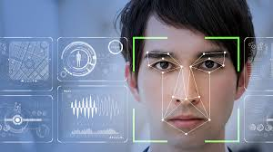
Proposed Solution
Integrated Multi-Layer Security:
Face Recognition: 3D facial landmark extraction.
Voice Recognition: 5-second voice sample validation.
Security Questions: Personalized cognitive challenges.

Slide 11
System Architecture
Modules:
Registration:
Face data, voice recording, security questions.
Authentication:
Face recognition, voice matching, security question validation.
User Management:
Add, delete, and manage user data.

Slide 12
Implementation

Slide 13
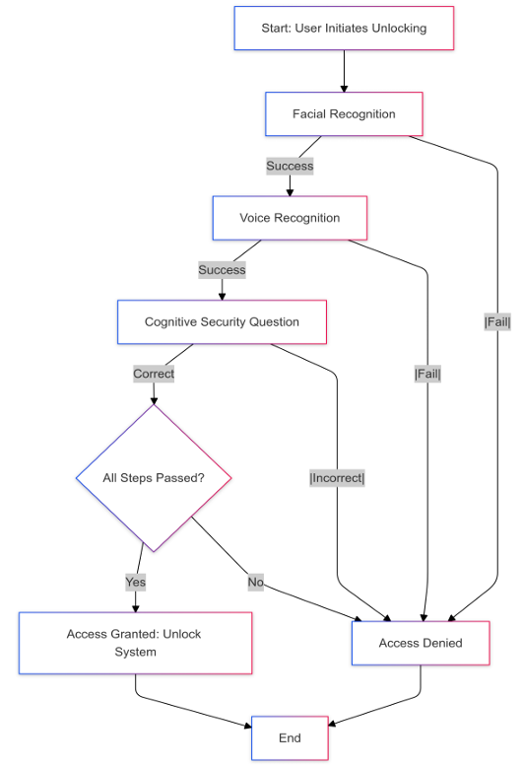
Real-time Authentication & Decision-Making Process Flowchart

Slide 14
PROTOTYPE AND IMPLEMENTATION:
System Workflow:
User Enrollment: Captures and stores biometric data securely.
Authentication Process: Requires success in face, voice, and cognitive verification.
Decision Module: Grants or denies access based on weighted scores.
Liveness Detection Techniques:
Face Recognition: Eye-blink detection to prevent photo-based spoofing.
Voice Recognition: Anti-replay attack mechanism.
Implementation Tools:
Programming Language: Python.
Frameworks Used: TensorFlow, OpenCV, Mediapipe, DeepSpeech.
Database: Secure encrypted biometric data storage.
Prototype Screenshots: (Include UI images)

Slide 15
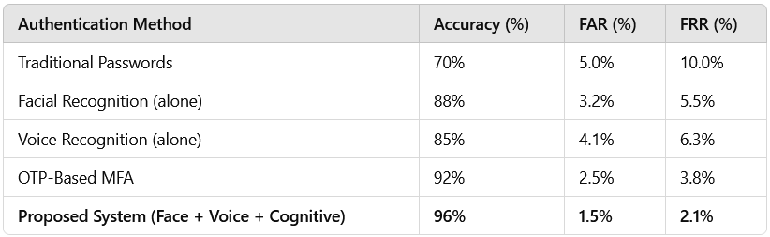
Evaluation and Testing Results

Slide 16
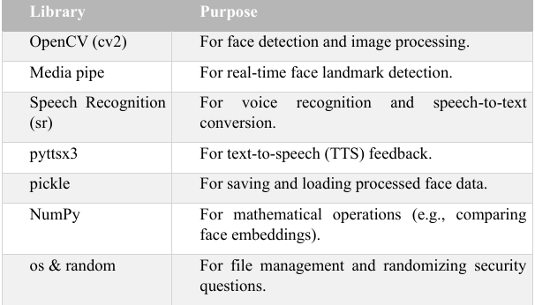
Python Libraries

Slide 17
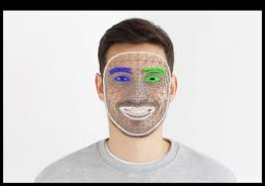



Technologies Used
Programming Language: Python
Libraries:
Mediapipe (Face Recognition).
OpenCV (Image and video processing).
SpeechRecognition (Voice Processing).
pyttsx3 (Text-to-Speech).
NumPy (Data computations).

Slide 18
Implementation
Data Storage:
Face Data: face_data/<user_id>.
Voice Data: voice_data/<user_id>.
Security Questions: security_questions/<user_id>.
Workflow:
Registration: Captures data.
Unlocking: Matches and validates user inputs.

Slide 19
Challenges and Solutions
Challenges Faced:
Spoofing Attacks: Implemented liveness detection for face and voice.
Environmental Factors: Normalization techniques for varying lighting & noise.
Usability Concerns: Optimized authentication time to be < 5 seconds.
How We Overcame Them:
Adaptive authentication compensates for temporary failures.
Dynamic cognitive security prevents brute-force guessing.

Slide 20
Flow Chart

Slide 21

Conclusion
Key Takeaways:
Developed a secure, multi-modal authentication system.
High security (96% accuracy) while maintaining usability.
Future scope: AI-powered security, expanded biometrics, blockchain integratio
Final Thoughts:
Addresses real-world security concerns effectively.
Balances security with user convenience.
Can be applied in enterprise and personal security domains.

Slide 22
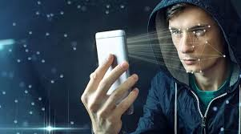
Future Scope
System Enhancements:
Expand biometric authentication to fingerprint & iris scanning.
Use AI-based anomaly detection to identify fraud.
Implement blockchain-based identity verification for decentralized security.
Broader Applications:
Smart home security.
Secure enterprise authentication.
IoT-based authentication systems

Slide 23


